Slide 1
Firefox & IE Configuration
Ryan Kim

Slide 2
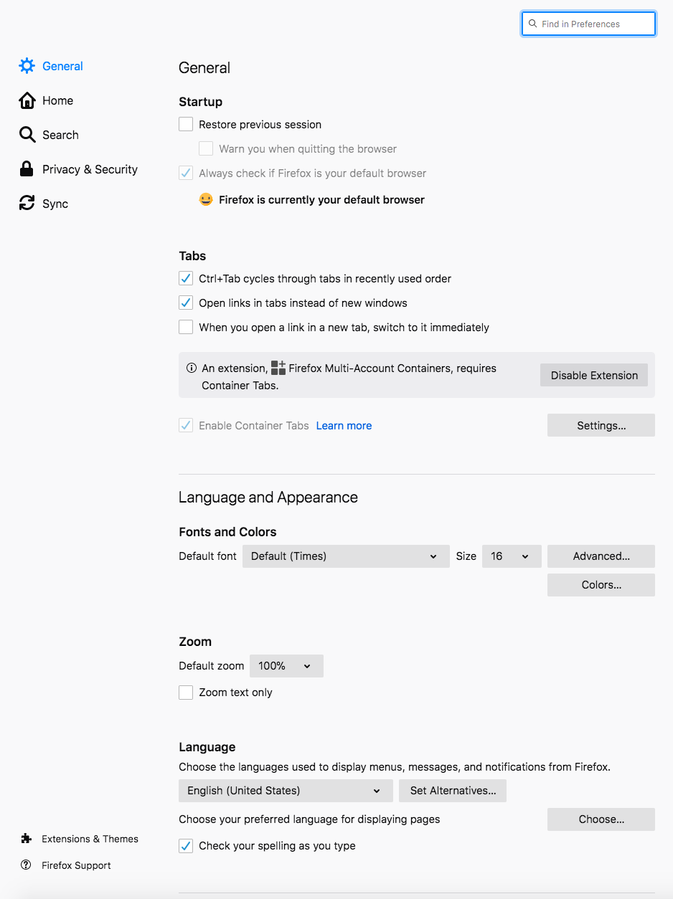
Firefox - Graphical Settings
about:preferences
Make sure Firefox is the default browser
Check Privacy & Security Tab

Slide 3
Firefox - Graphical Settings
Always send do not track
Delete cookies and site data
Do not save logins and passwords
Block pop-up windows
Warn when websites try to install add-ons
Block dangerous and deceptive content
Ask every time for certificates
Enable HTTPS only mode

Slide 4
Firefox - Add-ons
about:addons
Make sure to remove extensions and plugins

Slide 5
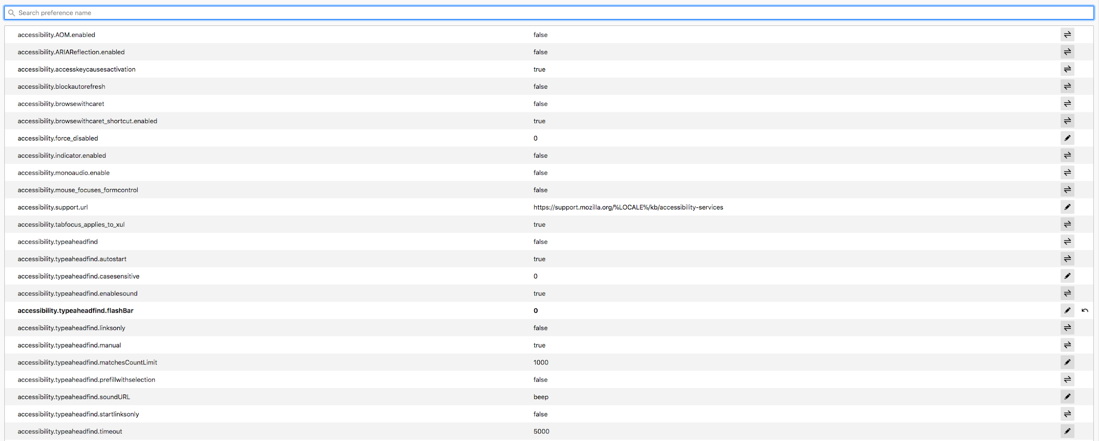
Firefox - Config Mode
about:config
bold indicates that the setting is not default

Slide 6
Firefox - Configuration Files
Stores info for about:config
Windows path: C:\Users\%USERNAME%\AppData\Roaming\Mozilla\Firefox\Profiles\some folder\prefs.js
Linux path (not as root): ~/.mozilla/firefox/something.default/prefs.js
Secure Config file: https://github.com/pyllyukko/user.js/
More info here: https://support.mozilla.org/en-US/kb/profiles-where-firefox-stores-user-data

Slide 7
Internet Explorer - Graphical Settings
Internet Options
Security Tab
Set all zones to max security level
Enable Protected mode for everything
Privacy
Checkmark everything
Disable Add-ons
Advanced
Review the security settings

Slide 8
Internet Explorer - Group Policy
Path: Admin Templates -> Windows Components -> Internet Explorer
Most important subdirectories: Privacy & Security Features
Relevant settings are in the Internet Explorer CIS Benchmark

